Slide 1
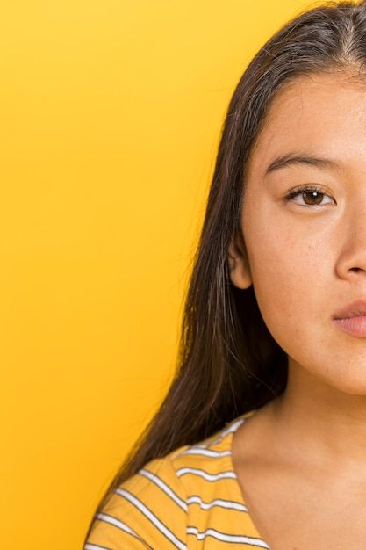
DEEPFAKE DETECTION
FOR HUMAN FACE IMAGES AND VIDEOS
GROUP MEMBERS
ASMI FAISEL
JOSIN JOSE
NANDHANA A
V H PRANAV
GUIDED BY
Ms. Nimitha Mary Mohan
Asst.Professor
Dept.of CSE

Slide 2

INTRODUCTION
Deepfake is a technique for fake media synthesis based on AI.
Deepfakes are created by combining and superimposing existing images and videos onto source images or videos using a deep learning technique , GAN.
This project explores the technology behind deepfakes, the growing threat they pose, and the innovative methods and tools developed to combat this formidable challenge.

Slide 3
ABSTRACT
The growing computation power has made creating an indistinguishable synthesized video called as deepfakes very simple.
Scenarios where deepfakes are used to create political distress, fake news, revenge porn, financial fraud are becoming common.
In response to the growing concern over deepfake technology's impact on media credibility, the project presents a comprehensive DFD system.

Slide 4
LITERATURE REVIEW

Slide 5
Sl No. | Paper | Published Year | Source | Advantages and Disadvantages
1 | Detecting GAN generated Fake Images using Co-occurrence matrices | 2019 | arXiv | Advantages: Shows robustness against JPEG compression. provides an end-to-end framework for detecting GAN-generated fake images, integrating co-occurrence matrices directly into a deep learning architecture. Disadvantages: may not be able to detect deepfakes that are generated using a different GAN architecture. Implementing such a system may require significant computational resources and expertise.
2 | Deepfake Video Detection Using Recurrent Neural Networks | 2020 | IEEE EXPLORE | Advantages: the system can capture temporal inconsistencies introduced by face-swapping processes.It is robust to variations in illumination and pose. Disadvantages:The performance of the system is highly dependent on the quality and diversity of the training data.

Slide 6
Sl No. | Paper | Published Year | Source | Advantages and Disadvantages
3 | Deepfake Detection Through Deeplearning | 2020 | IEEE EXPLORE | Advantages: 1)Xception has a high performance based On its benchmarking performance on the FaceForensics test Environment 2)Xception shown a relatively good performance over four different datasets Disadvantages: This method is useful when the corresponding detection model is used for Detection of each type of fake video. If the correspondence Between the model and the testing data was not followed, it is imapcted worsly.
4 | Exposing Deep Fakes Using Inconsistent Head Poses | 2020 | IEEE EXPLORE | Advantages: * It is relatively fast and efficient.It is robust to variations in facial appearance. Since the method is based on analyzing facial landmarks and head poses, it can potentially be applied to a wide range of media formats, including images and videos Disadvantages:* It may not be able to detect deepfakes that are generated using very sophisticated methods.It may not work well on deepfakes that are edited to make the head pose consistent

Slide 7
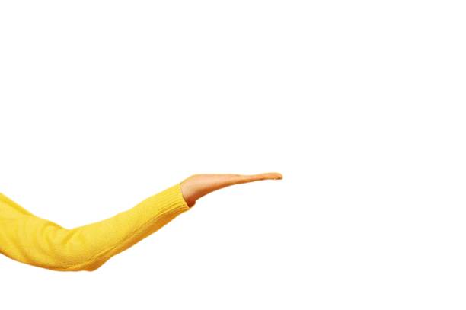
Sl No. | Paper | Published Year | Source | Advantage and Disadvantage
5 | FaceForensics++: Learning to Detect Manipulated Facial Images | 2019 | IEEE EXPLORE | Advantages: The FaceForensics++ dataset is the largest publicly available dataset for facial manipulation detection. The model is robust to different types of facial manipulations, including Face2Face, FaceSwap, DeepFakes, and NeuralTextures. Disadvantages: The model may not be able to detect deepfakes that are generated using new or unknown methods.
6 | Methods of Deepfake Detection Based on Machine Learning | 2020 | IEEE EXPLORE | Advantages: Artifacts on small moving parts such as hairs, eyebrows, eyelashes can help identify Deepfake manipulation better. Disadvantages: indicators such as skin smoothness or color mismatches, may have limitations in detecting Deepfake manipulation.
ABSTRACT
The growing computation power has made the deep learning algorithms so powerful that creating an indistinguishable human synthesized video popularly called as deep fakes have became very simple.
Scenarios where these realistic face swapped deep fakes are used to create political distress, fake terrorism events,revenge-porn, blackmail peoples are easily envisioned.
In response to the growing concern over deep fake technology's impact on media credibility, this project presents a comprehensive DFD system with a user-friendly graphical interface.

Slide 8
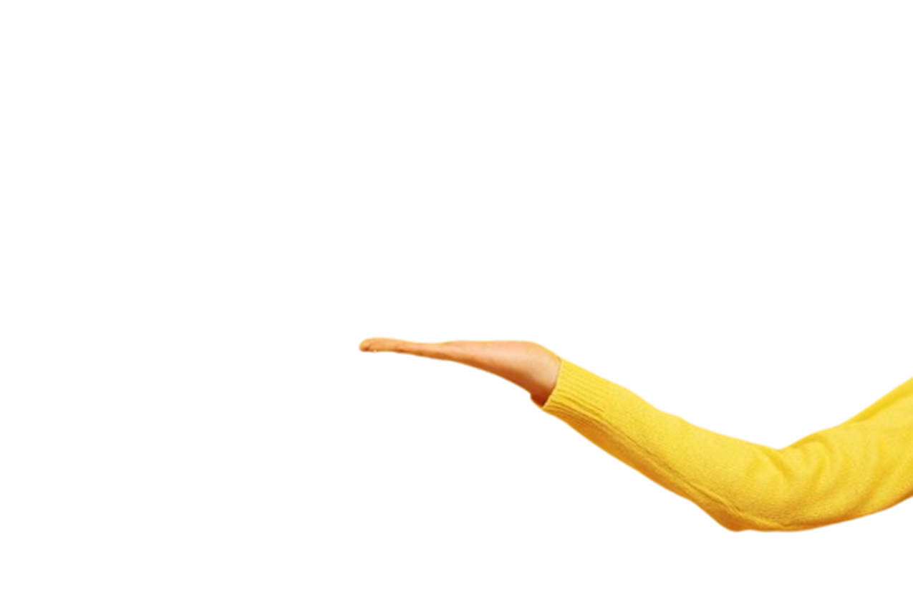
SYSTEM REQUIREMENTS
Hardware Specification
Processor: i5 or i7
RAM: 8GB (Minimum)
Storage: 500GB SSD or above
Software Specification
Tool: Python IDLE, Anaconda
Python: version3
Libraries : Tensorflow, OpenCV, Numpy, Tkinter

Slide 9
DESIGN DIAGRAMS

Slide 10

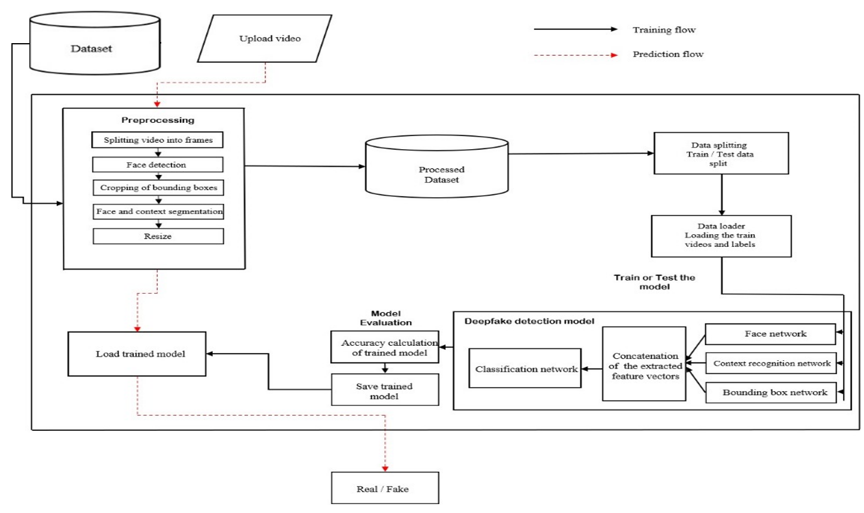
BLOCK DIAGRAM

Slide 11
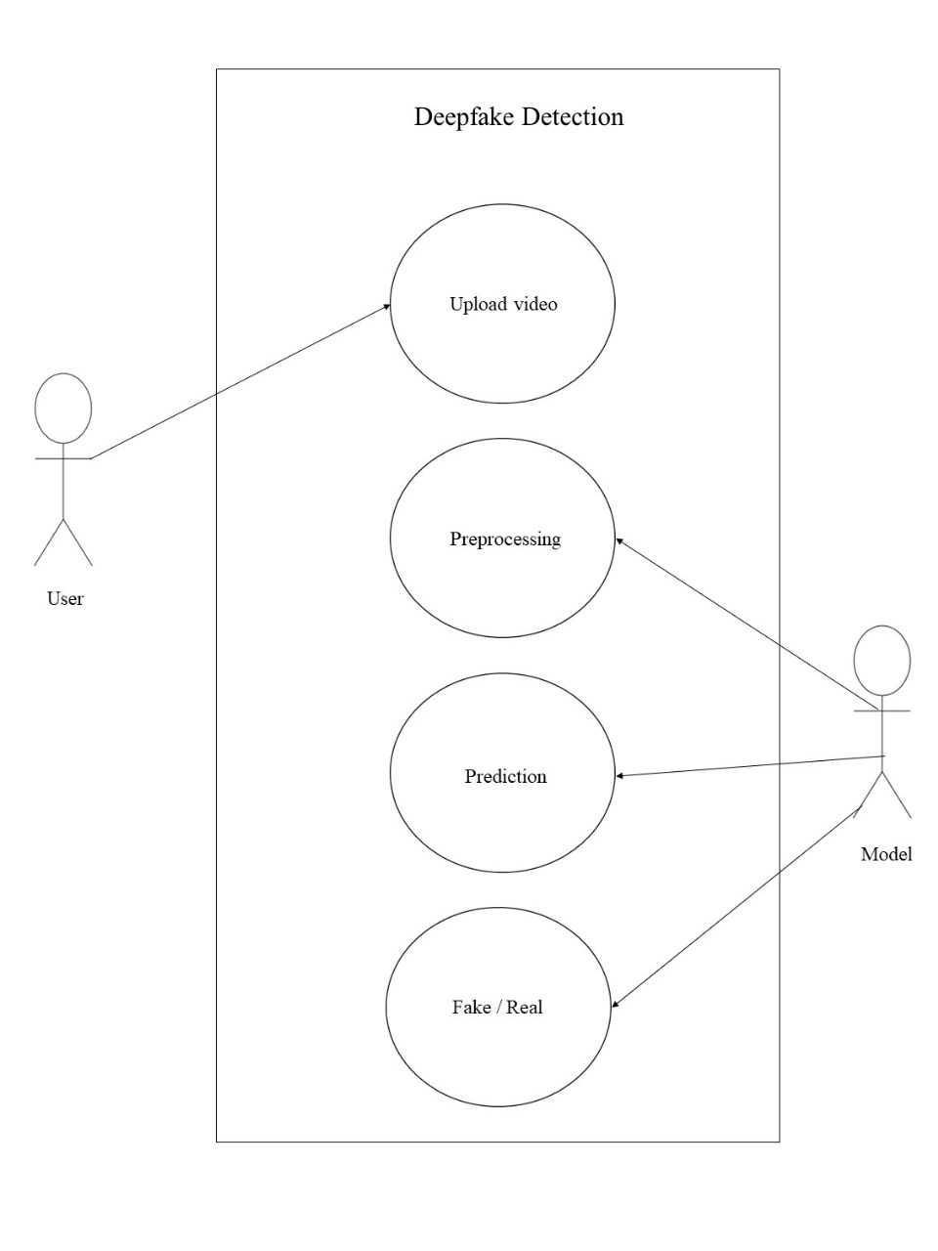
USE CASE DIAGRAM

Slide 12
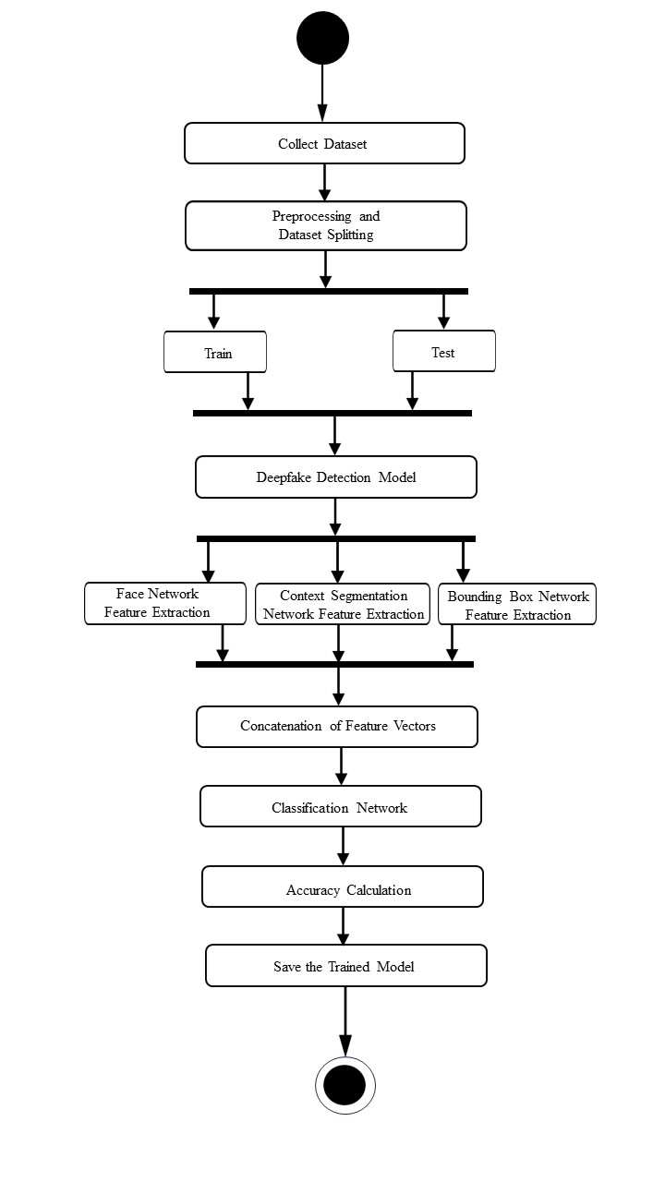
ACTIVITY DIAGRAM
Training Workflow

Slide 13
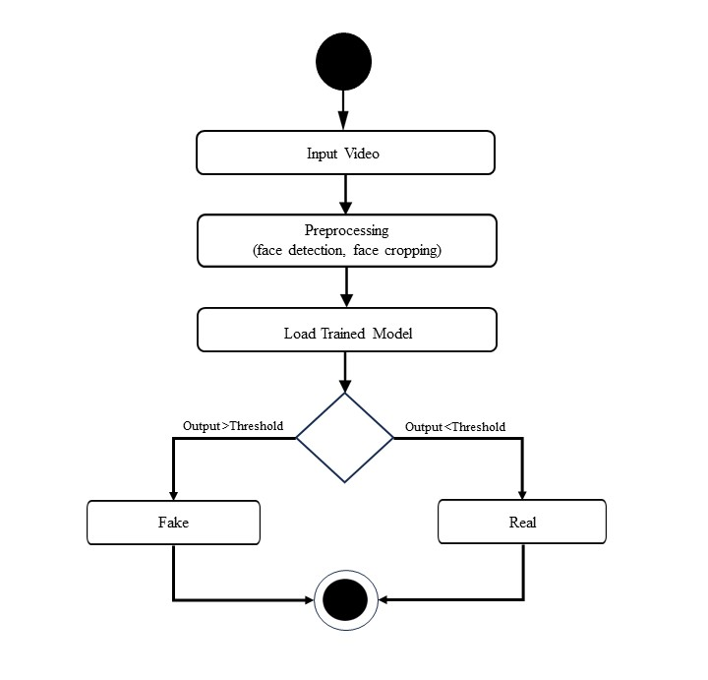
ACTIVITY DIAGRAM
Prediction workflow

Slide 14
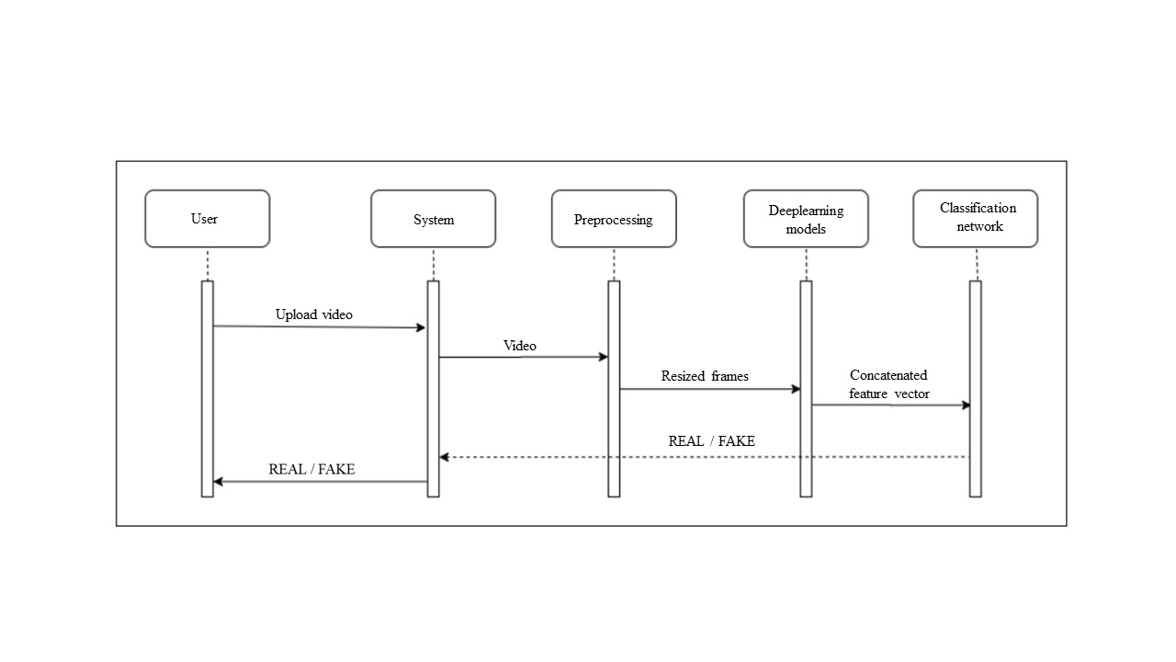
SEQUENCE DIAGRAM

Slide 15
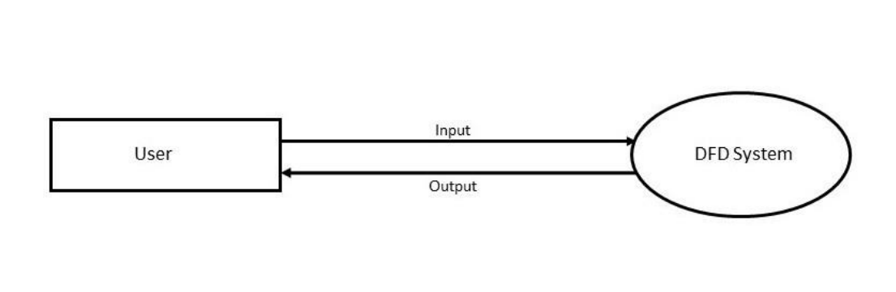
DFD LEVEL 0

Slide 16
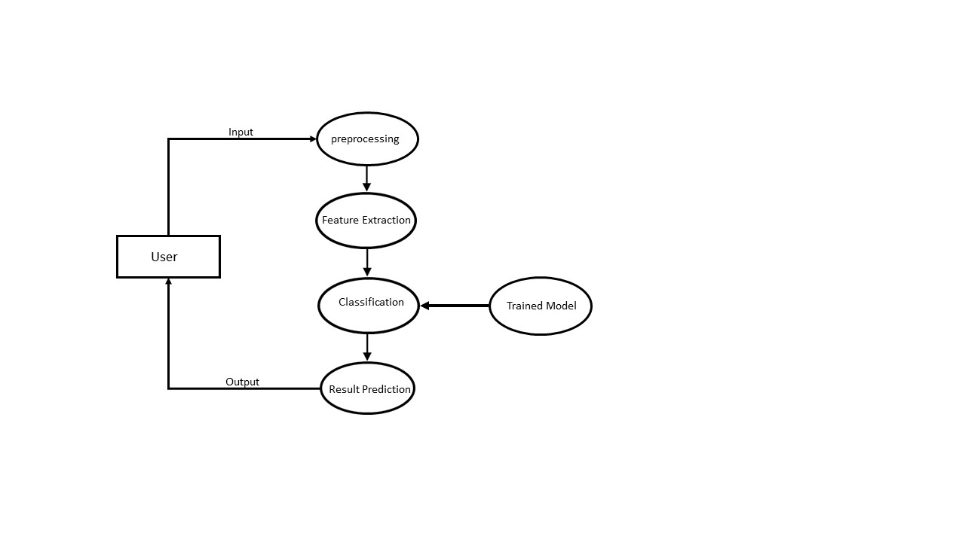
DFD LEVEL 1

Slide 17
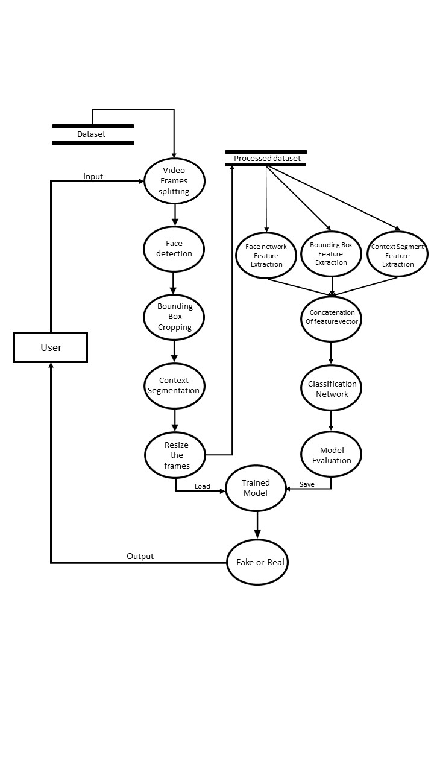
DFD LEVEL 2

Slide 18
IMPLEMENTATION

Slide 19
1. DATASET LOADING
FaceForensics++ dataset which is publicly available is used.
It contains videos and images manipulated using deepfakes, face2face and faceswap methods .

Slide 20
2. PREPROCESSING OF DATASET
- Extraction of video frames
- Perform face detection
- Cropping of bounding boxes
- Perform Face Segmentation
- Perform Context Segmentation

Slide 21
2.1 EXTRACTION OF FRAMES
Video File Access:
-Video files are accessed using the OpenCV library's VideoCapture object.
-20 frames are read from each file.
Iterative Extraction:
frames are extracted iteratively from each video file.
Frame Storage:
Extracted frames are stored as individual image files in predefined directories.
PREPROCESSING OF DATASET

Slide 22

2.2 BOUNDING BOX FACE DETECTION
For each frame in the 'fake' and 'real' directories ,attempt for face detection using Haar cascades is done.
If a face is detected in the image, a rectangle is drawn around the detected face
The ROI containing the detected face is cropped .
The cropped face image is then saved in a new directory

Slide 23
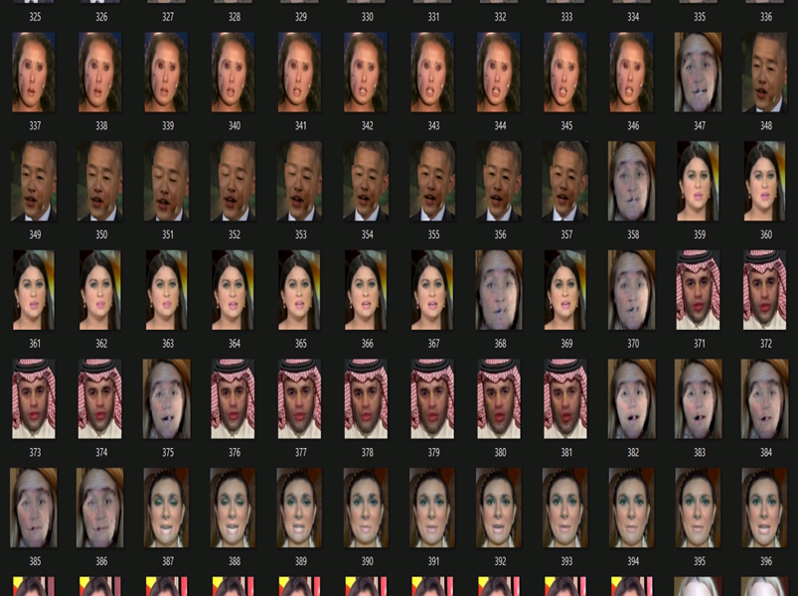
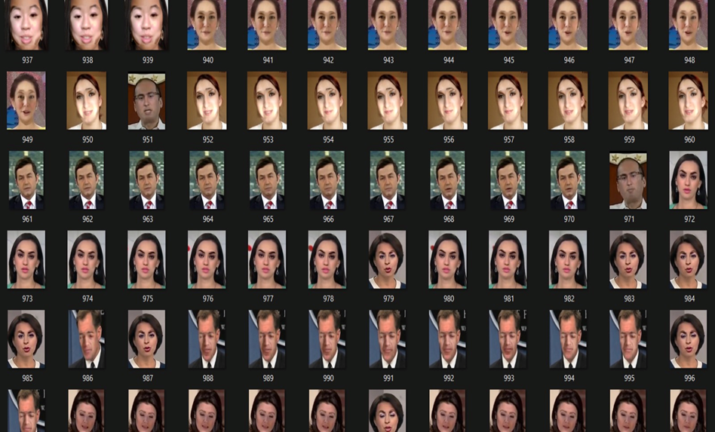
2.2 BOUNDING BOX FACE DETECTION
2000+ frames obtained in both real and fake directories
SAMPLE FRAMES EXTRACTED

Slide 24
2.3 FACE SEGMENTATION
Use MediaPipe's FaceMesh model for detecting facial landmarks in each image.
Process each image to detect facial landmarks.
Extract the facial landmarks coordinates.
Creating Face Mask:
Define the face oval using predefined landmarks from MediaPipe.
Draw lines between the landmark points to form the face mask.
Applying Mask:
Apply the face mask to the original image to retain only the facial region.
Save the processed image with the face mask applied.

Slide 25

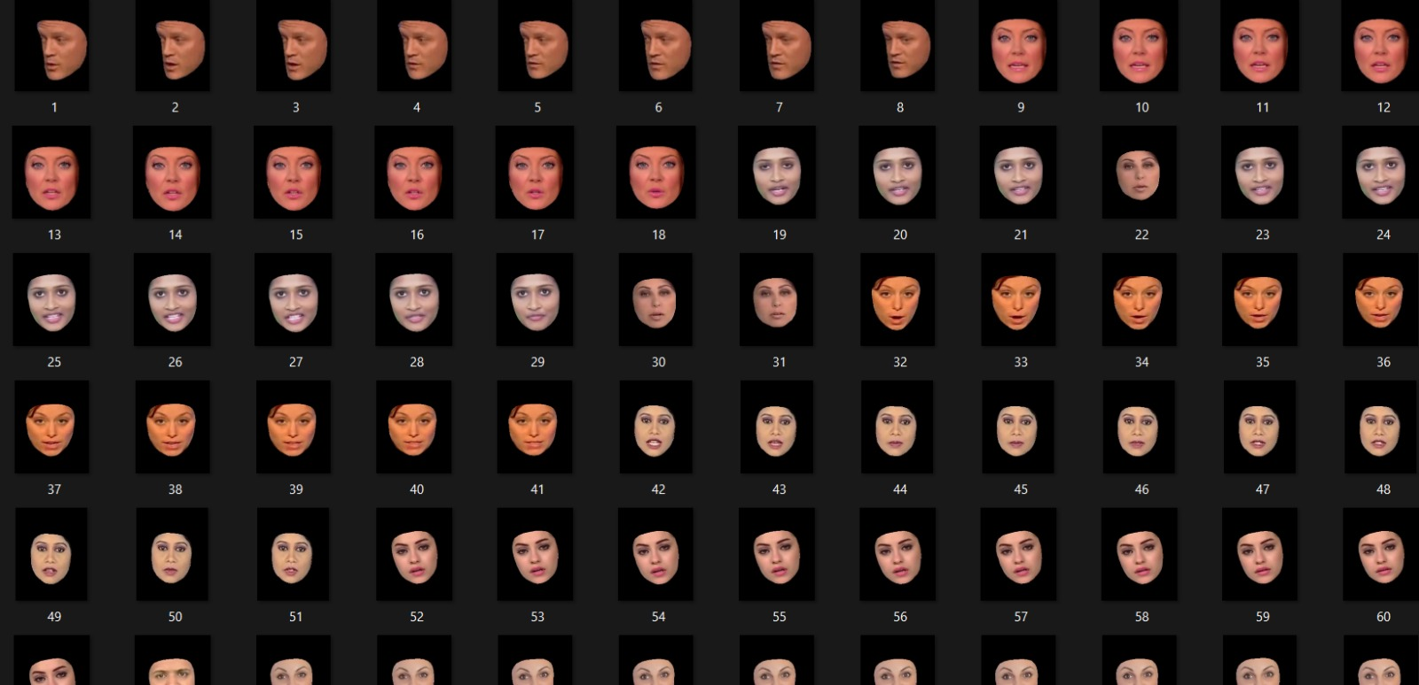
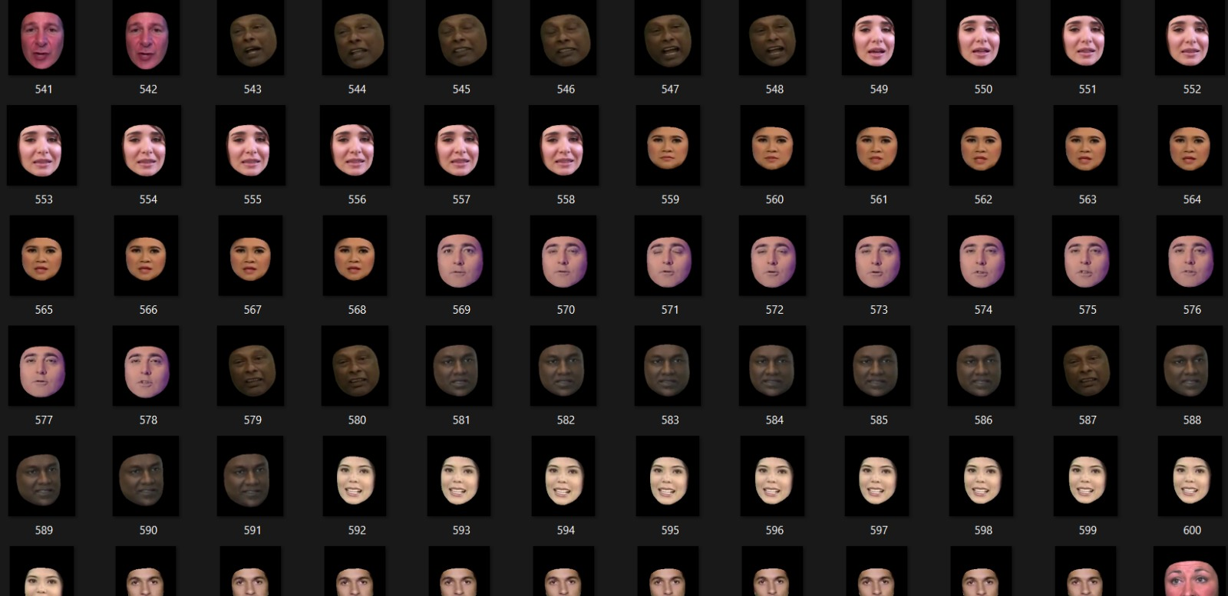
2.3 FACE SEGMENTATION
2000+ frames in both fake and real directories

Slide 26
2.4 CONTEXT SEGMENTATION
Face Detection and Landmark Extraction
Uses MediaPipe's Face Mesh model to detect facial landmarks in the image.
Creating the Mask
Once the facial landmarks are detected, a binary mask is created. The facial landmarks are used to define a polygonal region covering the face.
Applying Mask
The resulting binary mask will have the facial region masked and the surrounding context is extracted.
Save the processed image with the face mask applied.

Slide 27
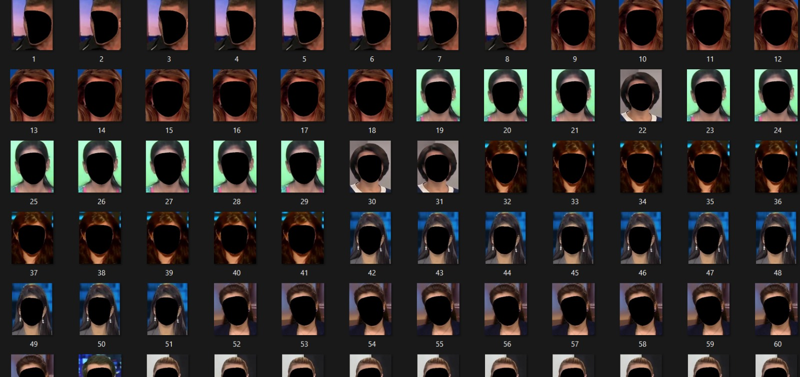
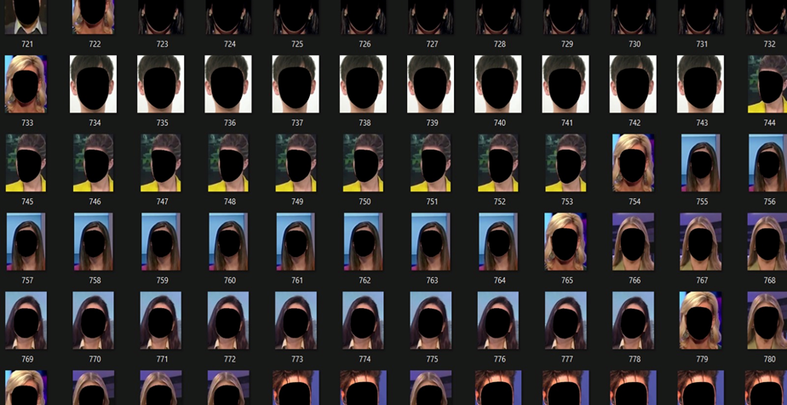

2.4 CONTEXT SEGMENTATION
2000+ frames in both fake and real folders combined.
SAMPLE FRAMES EXTRACTED

Slide 28

3. DEEPFAKE MODEL
ARCHITECTURE CREATION
Three customized networks are created for feature extraction –
Bounding Box Network
Face Network
Context Recognition Network
The resulted extracted features are concatenated and fed to
Classification Network.

Slide 29
3.1 ARCHITECTURE FOR THE 3 FEATURE EXTRACTION NETWORKS
Input Layer
The input layer implicitly defines the input shape of images as (128, 128, 3), indicating images of height 128, width 128, and 3 color channels (RGB).
Hidden Layers
Multiple convolutional layers are stacked to extract hierarchical features from the input images.
These convolutional layers are followed by activation functions (ReLU), batch normalization, max-pooling, and dropout layers.
Output Layer
Single output node representing the probability of an input image.
A sigmoid activation function is applied to the output node to squash the output values between 0 and 1.
DFD MODEL ARCHITECTURE

Slide 30
3.2 MULTI-MODAL CLASSIFICATION MODEL ARCHITECTURE
Input Layer:
In the sequential model used, the Flatten layer is the first layer in the model.
It flattens the input data into a one-dimensional array.
Hidden Layer :
A single Dense layer
It receives the flattened input data and applies a set of weights to transform the input.
The layer also applies the sigmoid activation function to introduce non-linearity into the model.
Output Layer:
The output layer of the model is also a Dense layer with a single neuron.
It utilizes the sigmoid activation function to squash the output into the range [0,1] .
The output layer essentially makes the final decision regarding the classification of the input data.
DFD MODEL ARCHITECTURE

Slide 31
4. TRAINING PROCESS
GENERAL STEPS
DATA LOADING AND RESIZING
ASSIGN LABELS [0 – REAL AND 1- FAKE]
MODEL COMPILATION – ADAM OPTIMIZER IS USED
TRAINING PROCESS
SAVE THE BEST MODEL

Slide 32
TRAINING PROCESS
Training data and labels are provided as input.
The number of training epochs is set to 60.
During training, the model adjusts its internal parameters (weights and biases) to minimize the loss function and improve its ability to correctly classify images.
At the end of each epoch, the model's performance on the training data is evaluated.
MODEL CHECKPOINTING
A ModelCheckpoint callback is defined to save the model with the best accuracy seen during training.
The callback monitors the 'accuracy' metric and saves the model weights to a file whenever there's an improvement in accuracy compared to the previous best model.
SAVING THE MODELS
After training completes, the trained model is saved.
TRAINING PROCESS

Slide 33
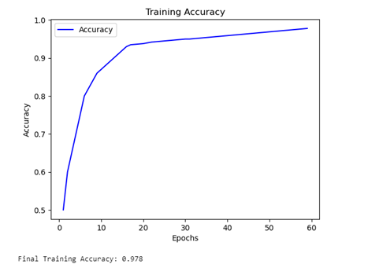
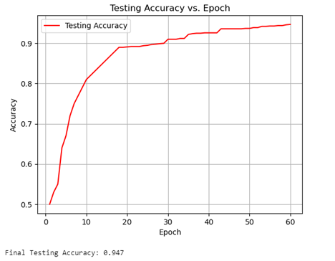
TRAINING AND TESTING ACCURACY
FINAL TRAINING ACCURACY SCORE : 0.978
FINAL TESTING ACCURACY SCORE : 0.947
TRAINING PROCESS

Slide 34
5. PREDICTION PROCESS
Input video or image
Load Trained model
Read frames from the input video(Only for video)
Perform face detection and Bounding box cropping
Perform Face and Context Segmentation
Feature Extraction
Feature vectors are concatenated into a single vector
Classify as REAL or FAKE

Slide 35
6. FRONTEND GUI DESIGN AND MODEL INTEGRATION
PYTHON TKINTER IS USED FOR GUI DESIGN
The GUI allows users to either select an image or a video file.
Once a file is selected, the GUI utilizes a combination of deep learning models to predict whether the content is real or fake.
USER INTERFACE COMPONENTS
The GUI consists of various graphical components such as buttons, frames, labels, and file dialogs.
These components are arranged to create an intuitive and user-friendly interface for interacting with the application.

Slide 36
FRONTEND GUI DESIGN AND MODEL INTEGRATION
MODEL INTEGRATION
The GUI integrates multiple deep learning models for different stages of the detection process, including bounding box detection, facial analysis, and contextual analysis.
The deepfake detection models (model1, model2, model3, model4) are loaded using Keras (load_model()).
FEEDBACK MECHANISM
The GUI provides feedback to the user in the form of prediction results displayed in message boxes.
After selecting an image or video, the user can click the "Predict" button to initiate the detection process. The predicted result (real or fake) is then presented to the user through a message box.

Slide 37
RESULTS

Slide 38
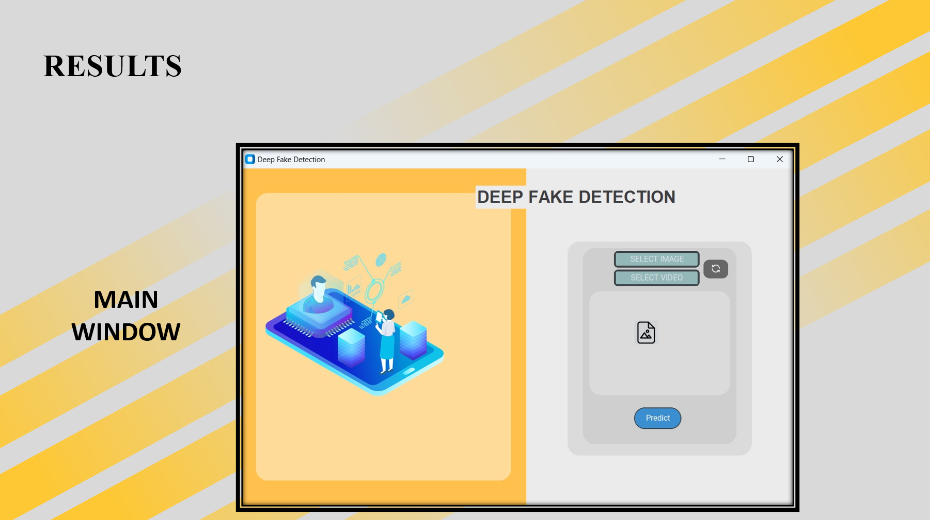

Slide 39
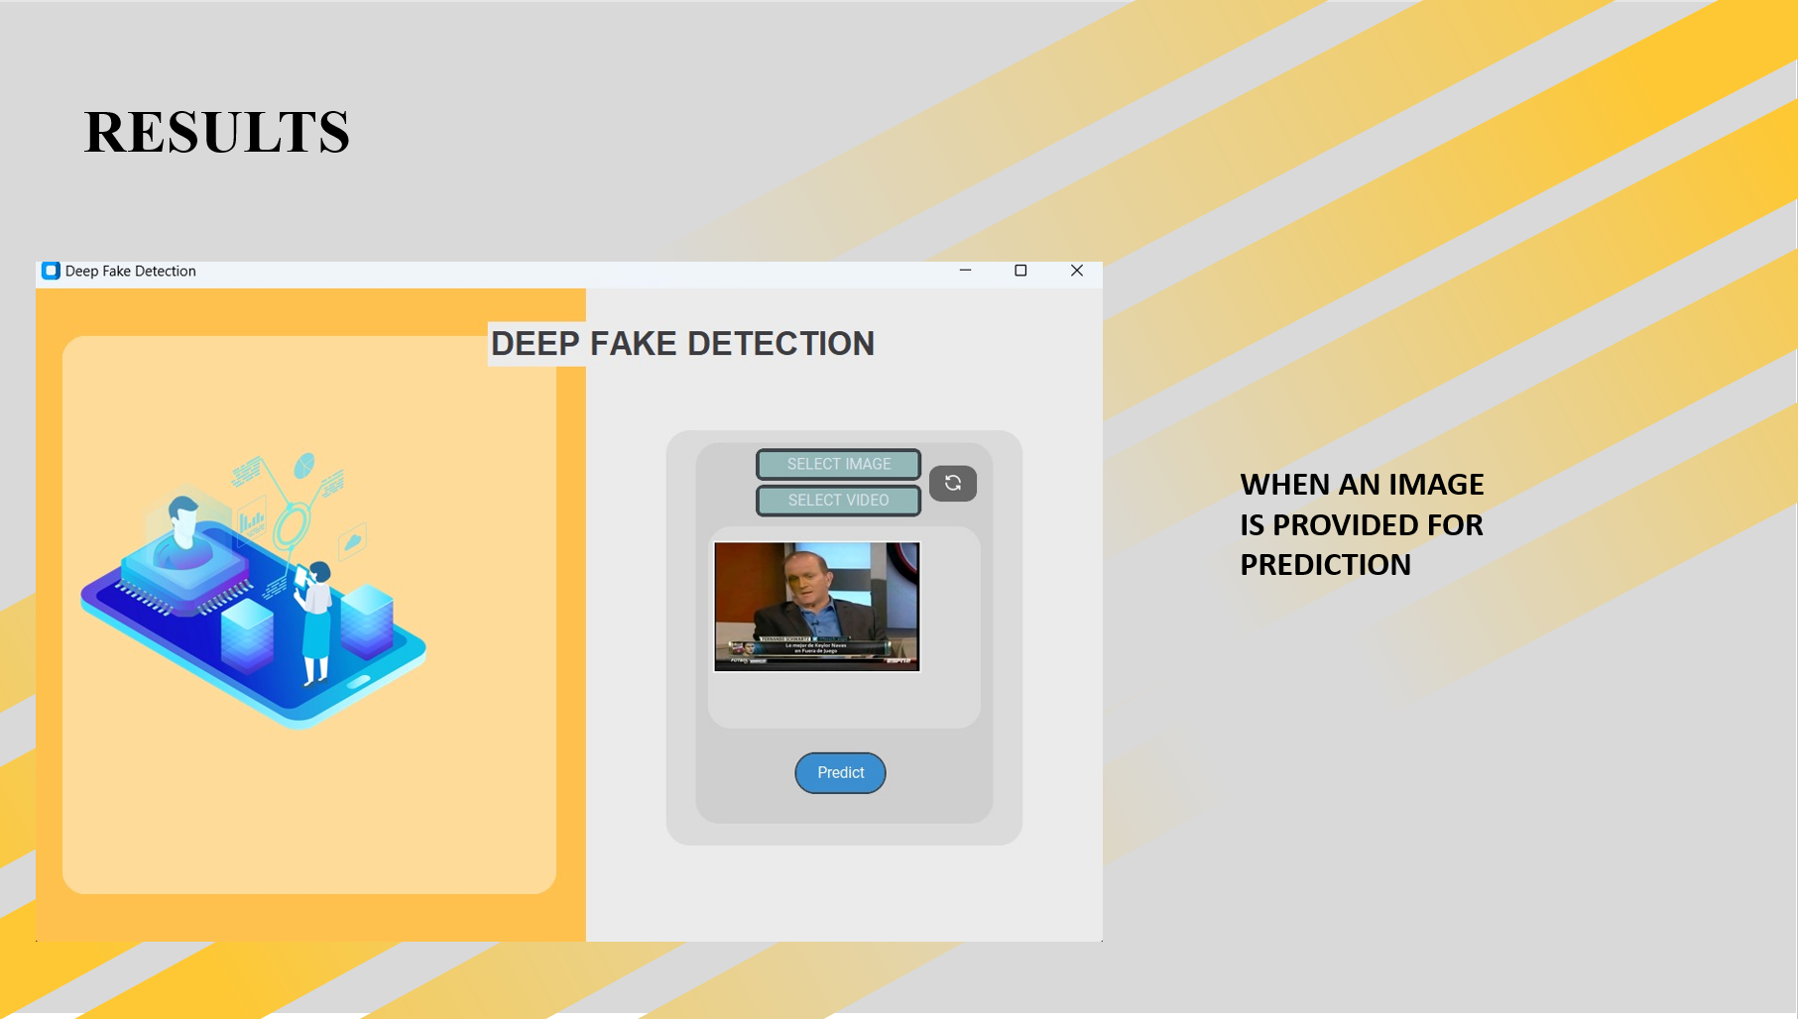

Slide 40
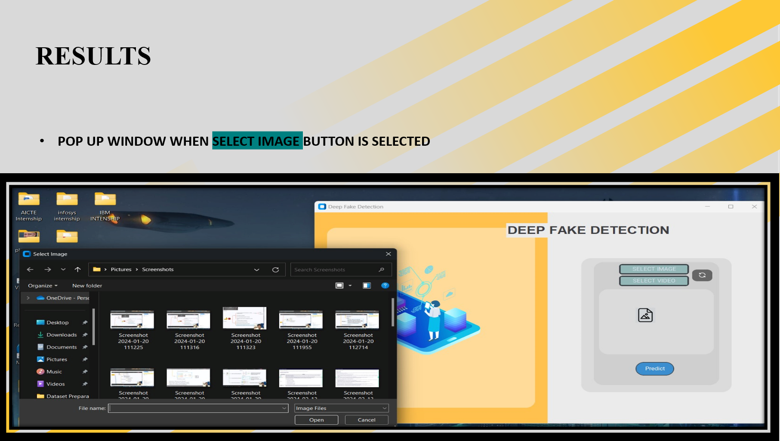

Slide 41
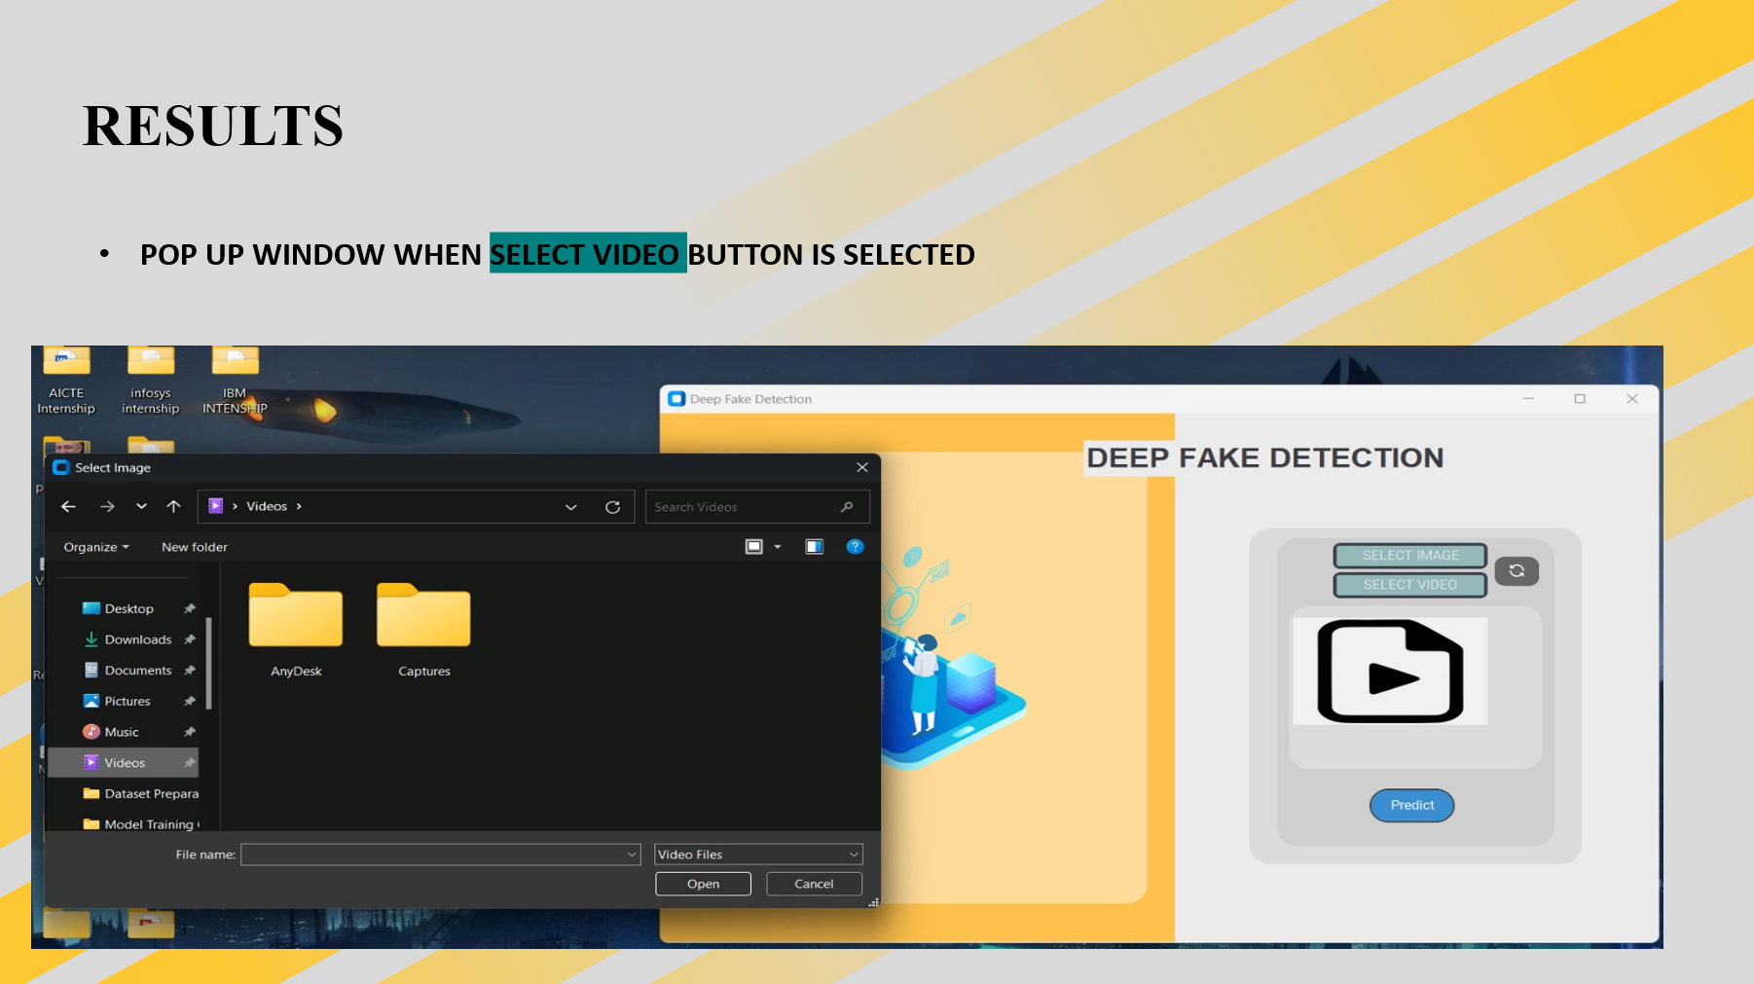

Slide 42
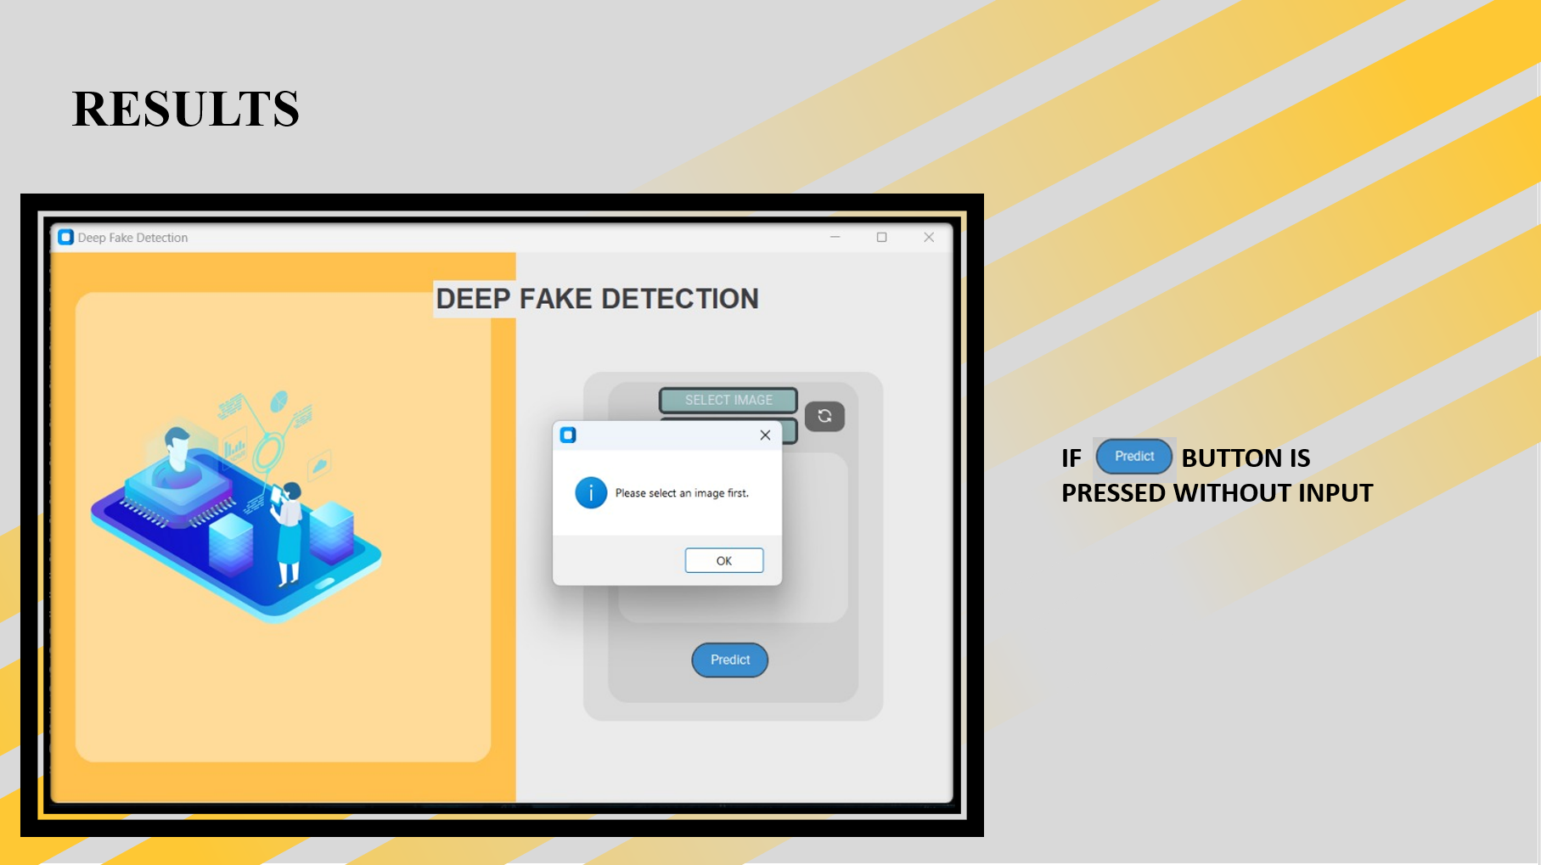

Slide 43
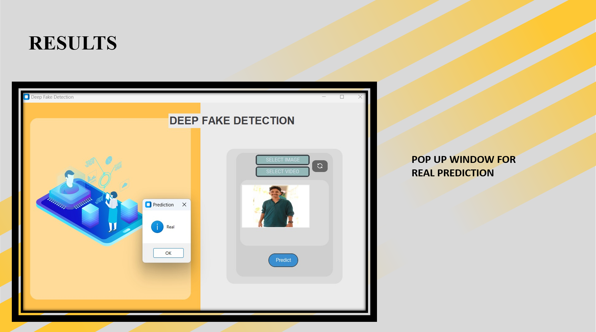

Slide 44
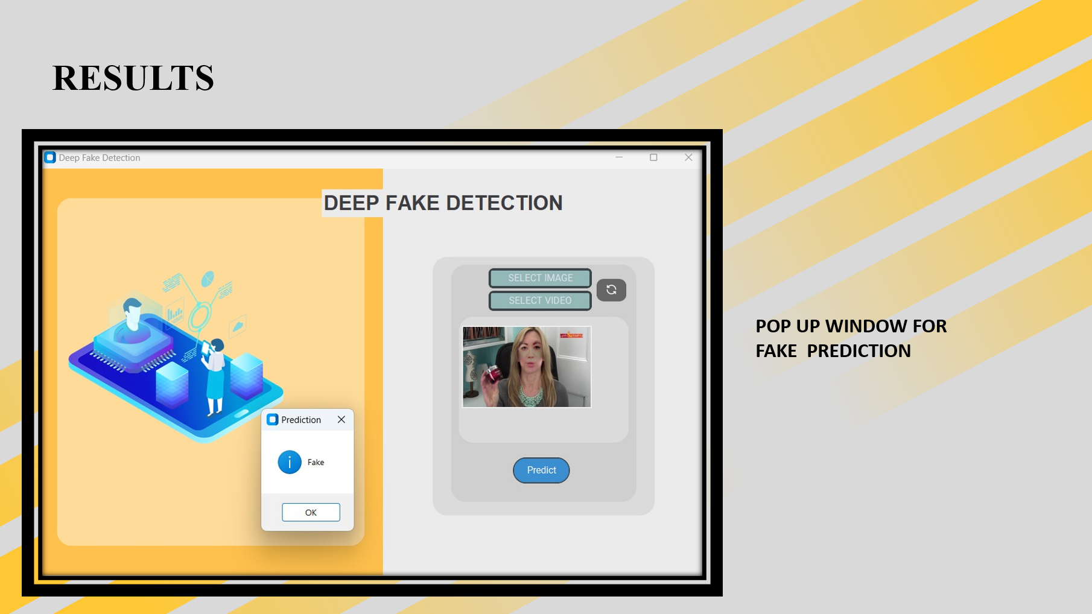

Slide 45

CONCLUSION
The development of deepfake detection technologies represents a crucial step in addressing the growing threat of manipulated multimedia content.
It is essential to acknowledge that the cat-and-mouse game between deepfake creators and detection algorithms is ongoing, and continual research and development in this field are necessary.
Deepfake detection is a valuable tool in the fight against misinformation, it should be part of a broader strategy that includes media literacy, responsible content creation, and legal frameworks to address this evolving threat effectively.

Slide 46
FUTURE SCOPE
Multimodal Detection:
Combining analysis of both visual and audio elements will become more prevalent.
Detecting inconsistencies between lip movements and speech, for example, can enhance deepfake detection.
Real-Time Detection:
The development of real-time deepfake detection tools will be crucial, especially for live video conferencing, social media platforms, and other applications where rapid detection is essential.

Slide 47
REFERENCES
Detecting GAN generated Fake Images using Co-occurrence Matrices Lakshmanan Nataraj; Mayachitra Inc., Santa Barbara, California, USAhttps://doi.org/10.2352/ISSN.2470-1173.2019.5.MWSF-532 © 2019, Society for Imaging Science and Technology
Güera D.Delp, E.J. Deepfake video detection using recurrent neural networks. In Proceedings of the 2020 15th IEEE International Conference on Advanced Video and Signal Based Surveillance (AVSS), Auckland, New Zealand, 27–30 November 2020
Deepfake Detection through Deep Learning Deng Pan, Lixian Sun, Rui Wang, Xingjian Zhang, Richard O. Sinnott 2020 IEEE/ACM International Conference on Big Data Computing, Applications and Technologies (BDCAT)
Li, Y.; Lyu, S. Exposing deepfake videos by detecting face warping artifacts. arXiv 2020, arXiv:1811.00656.
Ismail, A.; Elpeltagy, M.; S. Zaki, M.; Eldahshan, K. A New Deep Learning-Based Methodology for Video Deepfake Detection Using XGBoost. Sensors 2021, 21, 5413. https://doi.org/10.3390/s21165413
Li, Y.; Chang, M.C.; Lyu, S. In ictu oculi: Exposing ai created fake videos by detecting eye blinking. In Proceedings of the 2019 IEEE International Workshop on Information Forensics and Security (WIFS), Hong Kong, China, 11–13 December 2019
FaceForensics++: Learning to Detect Manipulated Facial Images Andreas Rossler Davide Cozzolino Luisa Verdoliva Christian Riess Justus Thies Matthias Nießner 2019 IEEE/CVF International Conference on Computer Vision (ICCV)
Methods of Deepfake Detection Based on Machine Learning Artem A. Maksutov1, Viacheslav O. Morozov, Aleksander A. Lavrenov, Alexander S. Smirnov 2020 IEEE Conference of Russian Young Researchers in Electrical and Electronic Engineering (EIConRus) 10.1109/EIConRus49466.2020.9039057

Slide 48

THANK
YOU

